Slide 1
Data Ethics and Society
Amanda R. Kube Jotte
DSSI 2024
Slides taken in part from lectures by David Uminsky and Will Trimble
DSSI 2024

Slide 2
Why do ethical issues arise in Data Science?
DSSI 2024

Slide 3
What ethical issues have you heard about - from where?
DSSI 2024

Slide 4
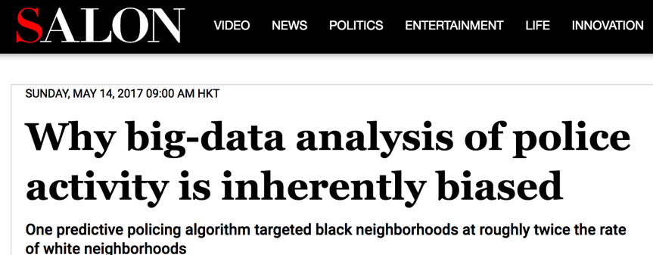

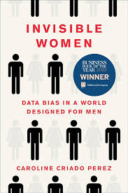
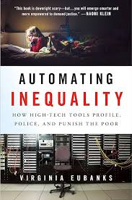
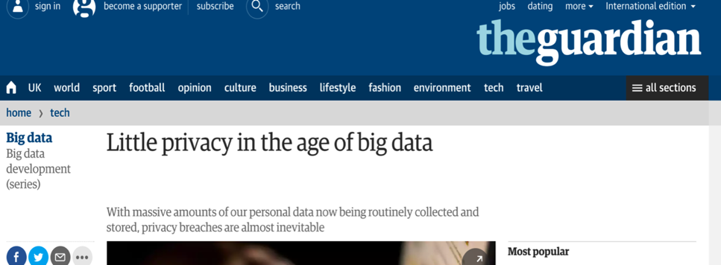
“With Big Data comes Big Responsibility”
DSSI 2024
DSSI 2024

Slide 5
When in the Data Scientific process do we have to worry about ethical issues arising?
DSSI 2024

Slide 6
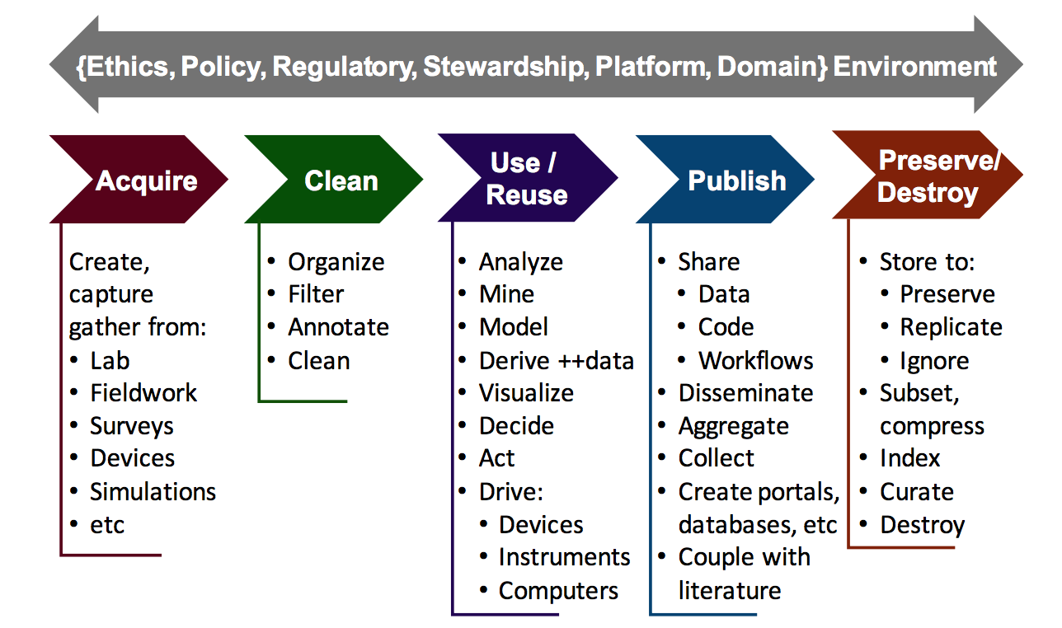
The Data Science Lifecycle
Communications of the ACM , April 2018
DSSI 2024

Slide 7
The Data Science Lifecycle
Let’s make a list
Communications of the ACM , April 2018
DSSI 2024

Slide 8
The Data Science Lifecycle
Let’s make a list
Communications of the ACM , April 2018
DSSI 2024

Slide 9
The Data Science Lifecycle
Let’s make a list
Communications of the ACM , April 2018
DSSI 2024

Slide 10
The Data Science Lifecycle
Let’s make a list
Communications of the ACM , April 2018
DSSI 2024

Slide 11
The Data Science Lifecycle
Let’s make a list
Communications of the ACM , April 2018
DSSI 2024

Slide 12
The Data Science Lifecycle
Let’s make a list
Communications of the ACM , April 2018
DSSI 2024

Slide 13
Data Science is increasingly used to feed ML/AI
You’ve used data science to feed AI and will continue to do this throughout the program
Let’s practice creating training data in a quick activity:
https://studio.code.org/s/oceans/lessons/1/levels/2 (complete levels 2 & 3)
Sometimes what we train AI to detect is not always concrete
Another quick illustrative activity: https://studio.code.org/s/oceans/lessons/1/levels/8 (complete level 8)
DSSI 2024

Slide 14
In the real world, who chooses how the data is labeled?
Who should choose?
https://www.moralmachine.net/
DSSI 2024

Slide 15
How do we know what the “right” decisions are?
DSSI 2024

Slide 16
Some relevant regulations
Belmont Report for Human Subjects research
HIPAA for medical data
FERPA for student data
GDPR - General Data Protection Regulation
DSSI 2024

Slide 17
Belmont Principles (1979)
The three fundamental ethical principles for using any human subjects for research are:
Respect for persons: protecting the autonomy of all people and treating them with courtesy and respect and allowing for informed consent. Researchers must be truthful and conduct no deception;
Beneficence: The philosophy of "Do no harm" while maximizing benefits for the research project and minimizing risks to the research subjects
Justice: ensuring reasonable, non-exploitative, and well-considered procedures are administered fairly — the fair distribution of costs and benefits to potential research participants — and equally.
This is the foundation for modern Institutional Review Boards (IRBs)
DSSI 2024

Slide 18
GDPR - General Data Protection Regulation
EU law on data protection and privacy for all EU citizens
Also addresses the transfer of personal data outside of the EU
Adopted 4/14/16, became enforceable 5/25/18
Some key requirements:
Lawful, fair, and transparent processing of Personal Data
Limitation of purpose, data, and storage
Subjects have right to know what data is kept, ask for correction, deletion…
Consent: must be documented and can be withdrawn at any time
Privacy by design (ensured by default)
Many other reporting and process requirements
Penalties: GDPR sets forth fines of up to 10 million euros, or, in the case of an undertaking, up to 2% of its entire global turnover of the preceding fiscal year, whichever is higher.
DSSI 2024

Slide 19
It isn’t always cut-and-dry…
DSSI 2024

Slide 20

The Right to be Forgotten
Every company doing business in the EU has to worry about GDPR.
Courts in the E. U. support the notion that factual reporting can be suppressed (at the search-engine level) to prevent reputational harm.
in 2009 when Mario Costeja, a Spanish lawyer, complained that entering his name in Google led to legal notices dating to 1998 in an online version of a Spanish newspaper that detailed his debts and the forced sale of his property.
DSSI 2024

Slide 21
(de-)Anonymization or (re-)Identification)
Most regulations address PII – Personally Identifiable Information
Name, Social Security Number, Employee Id, …
Combination of zip code, birth date and sex, uniquely identifies about 87% of Americans
“In 1997 Latanya Sweeney dramatically demonstrated that supposedly anonymized data was not anonymous. The state of Massachusetts had released data on 135,000 state employees and their families with obvious identifiers removed. However, the data contained zip code, birth date, and sex for each individual. Sweeney was able to cross reference this data with publicly available voter registration data to find the medical records of then Massachusetts governor William Weld.”
DSSI 2024

Slide 22
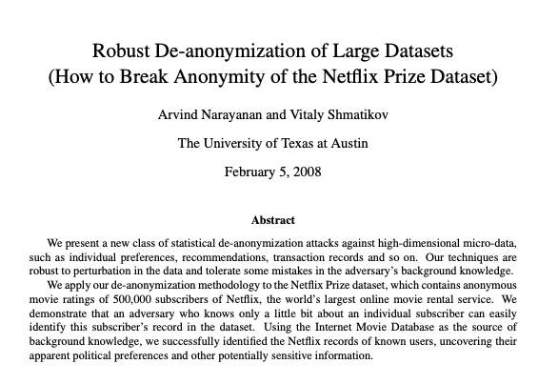
Another real-world example
Netflix Prize (anonymized data)
User_ID(anonymized), Movie, Ratings, Date
Merge with data from IMDb
With only a few ratings, user could be linked across the two systems
Their movie choices could be used to determine apparent political preferences and other potentially sensitive information, even if all their IMDb reviews revealed no such information
Lawsuit… can’t put the data back in the bag… Netflix doesn’t publish this dataset anymore.
DSSI 2024

Slide 23
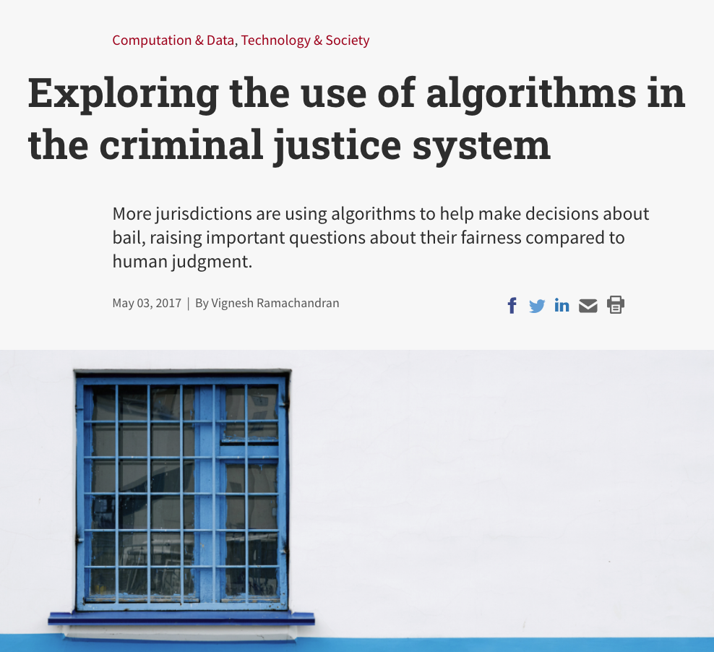
Algorithms and Models
Fairness and Bias
How can code be unfair or biased?
Reproducibility and “P-hacking”
Overfitting
Generalization (esp. for rare-events and long tails)
(lack of) Interpretability
DSSI 2024

Slide 24
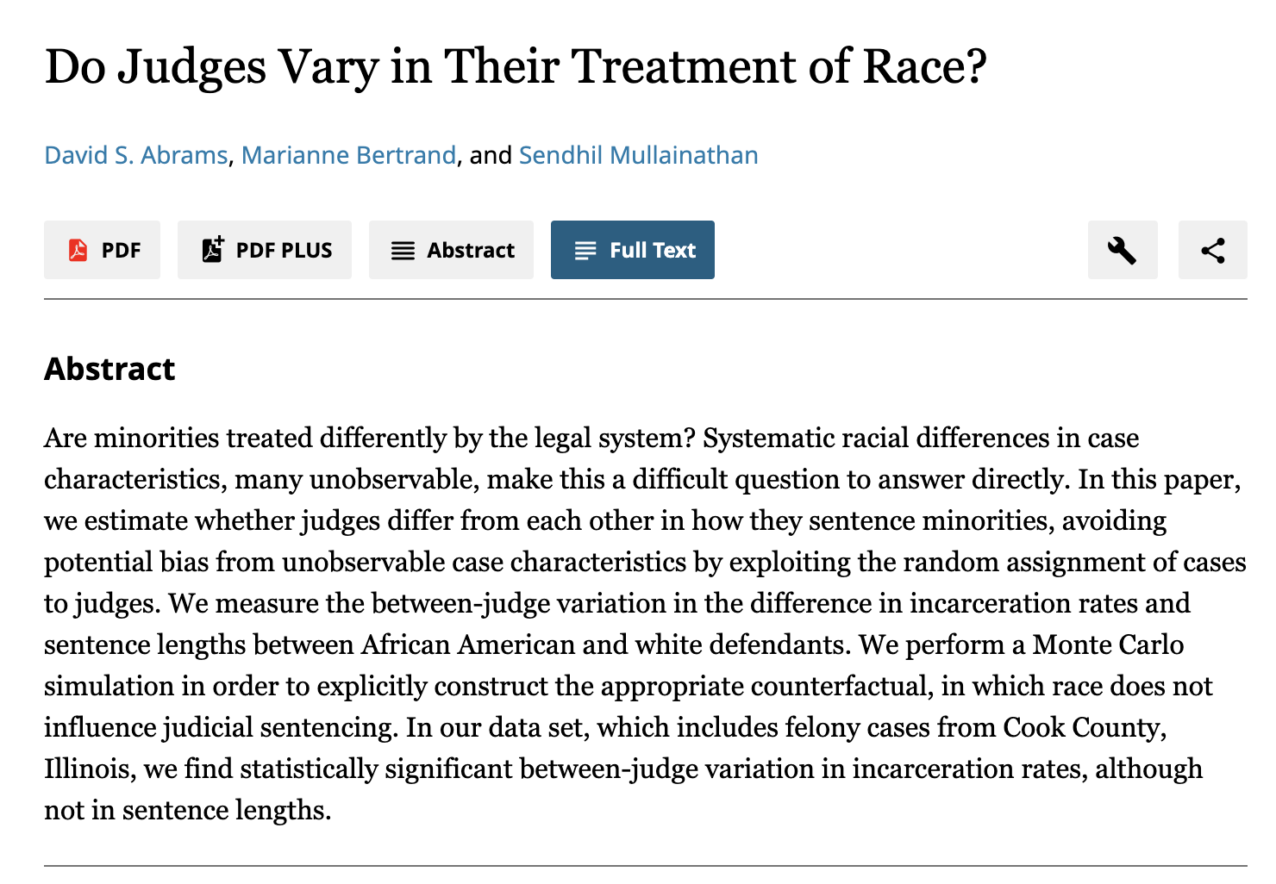
Case Study – Justice Systems & Algorithms
Human decision making and judgement has been the hallmark of our current justice system.
DSSI 2024

Slide 25

COMPAS Recidivism Prediction
How COMPAS works. 1) defendants fills out 137 question survey. 2) COMPAS software generates a score (from 1-10) of “Risk of Recidivism”
Analysis of COMPAS found by Larson et al. (2016)
Black defendants who did not recidivate over a two-year period were nearly twice as likely to be misclassified as higher risk compared to their white counterparts (45 percent vs. 23 percent)
White defendants who re-offended within the next two years were mistakenly labeled low risk almost twice as often as black re-offenders (48 percent vs. 28 percent).
Even when controlling for prior crimes, future recidivism, age, and gender, black defendants were 77 percent more likely to be assigned higher risk scores than white defendants.
DSSI 2024

Slide 26
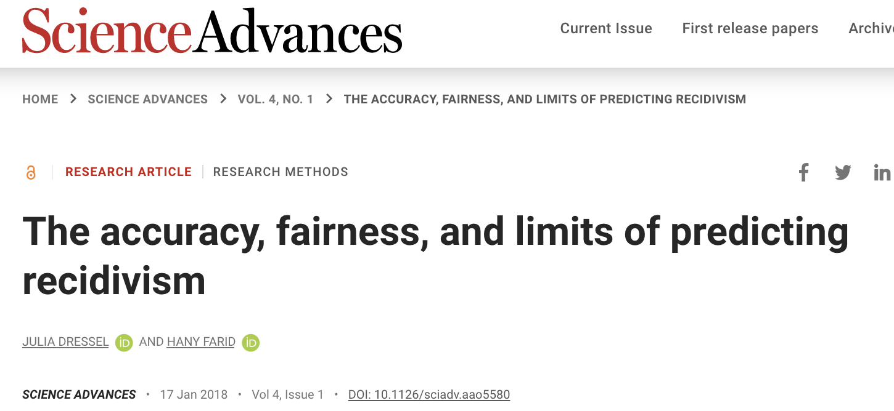
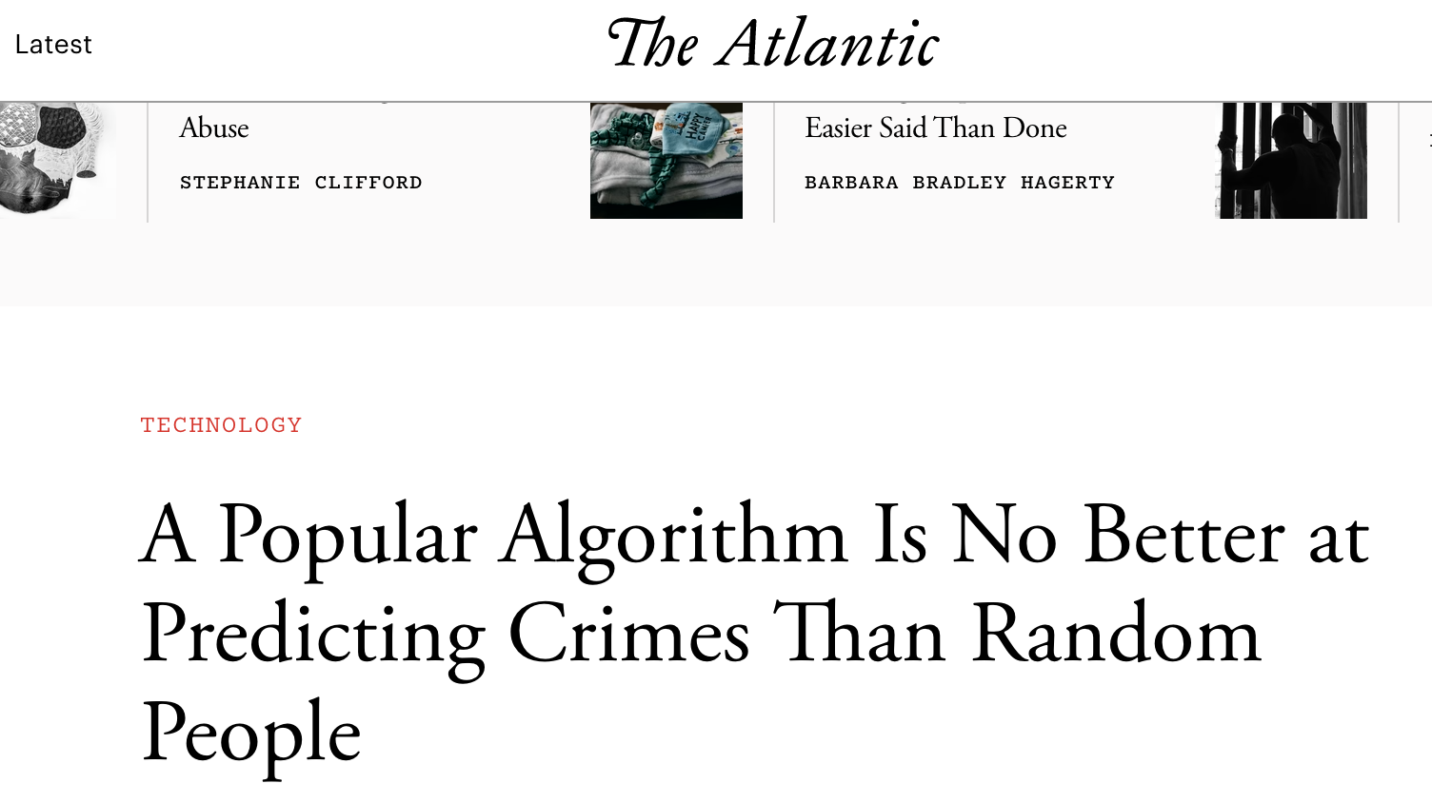
COMPAS Recidivism Prediction
Further salt in the wound… In 2018 a study showed that 20 random people guessing is as accurate as COMPAS
DSSI 2024

Slide 27
COMPAS Recidivism Prediction
Turns out COMPAS is really fair by other measures:
likelihood of recidivism among high-risk offenders is the same regardless of race (predictive parity),
it can discriminate between recidivists and non-recidivists equally well for white and black defendants
Turns out there are multiple definitions of fairness and its proveable that they are not all mutually satisfiable (Kleinberg et al).
Even more… Predicated on a single measure (re-arrest) is problematic
Key take away - It’s complicated and should give us pause and reflection on entire system.
DSSI 2024

Slide 28
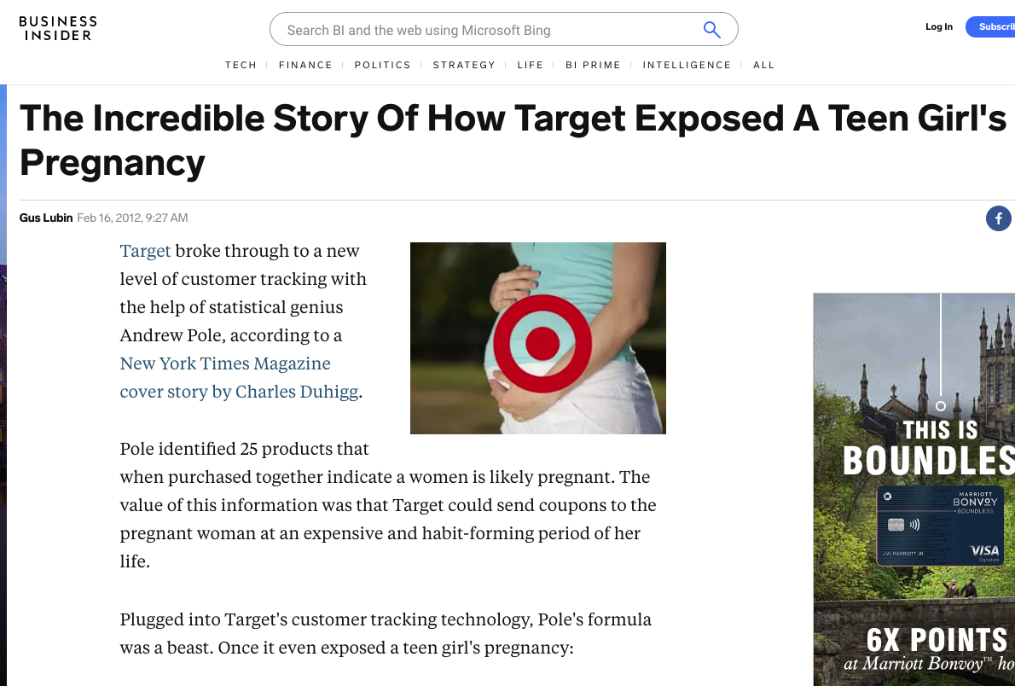
Case Study – Target predictive analytics
DSSI 2024

Slide 29
Trustworthiness and Accountability
Do decisionmakers understand what the analysis is doing?
Do action-takers understand the trust understand why they’re getting the recommendations they’re getting?
Do the people being acted on understand why?
People make all political decisions. What does it mean when people point at a machine and shrug “we don’t know” ?
DSSI 2024

Slide 30
Trustworthiness and Accountability
Who is accountable for the actions?
Who is coming up with the values encoded in the system?
How is the tradeoff between false positive and false negatives being set?
If you are harmed, and try to bring legal action against the entity that harmed you, how do you confront your accuser if your accuser is private historical data + trade-secret algorithm?
DSSI 2024

Slide 31
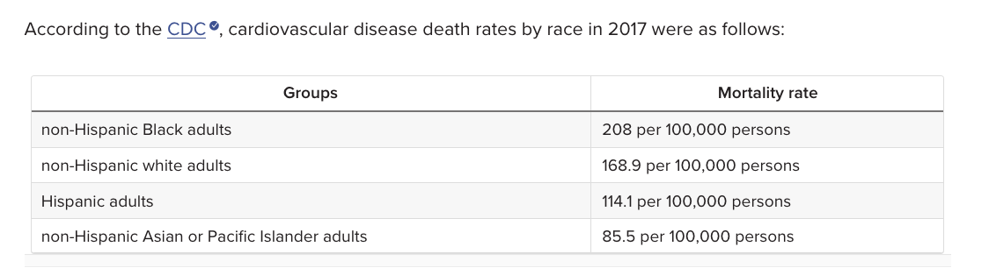
Race in medicine
It is straightforward to measure incidence, severity, and outcomes of disease by racial category. Facts of this sort fill the medical literature.
What do you do with this knowledge?
Do you want to use race in scoring disease severity / choosing treatment?
DSSI 2024

Slide 32
Sex in medicine
Sexual dimorphism introduces variability in medical outcomes. Researchers hate variability because it masks the (small) effects they need to detect to get promoted.
Historically you could get away with recruiting only men for many types of study, resulted in some bad clinical inferences. “Atypical” heart attack symptoms are more common in women than “typical” heart attack symptoms established from all-male cohort studies.
Some ailments affect one sex much more frequently for apparently biological reasons.
Disaggregation by sex is always the first step; see if differences are there.
Sex-specific normative growth charts for children birth to 12 years are established by the CDC and the WHO. Which blood labs should be sex-adjusted?
DSSI 2024

Slide 33
Not straightforward
What does fairness mean?
E.g., Kleinberg et al. conflicting notions
Is privacy more important than right to life or healthcare?
Yours vs. someone else’s?
Is all public data fair game?
For any use?
DSSI 2024

Slide 34
What to do about it?
DSSI 2024

Slide 35
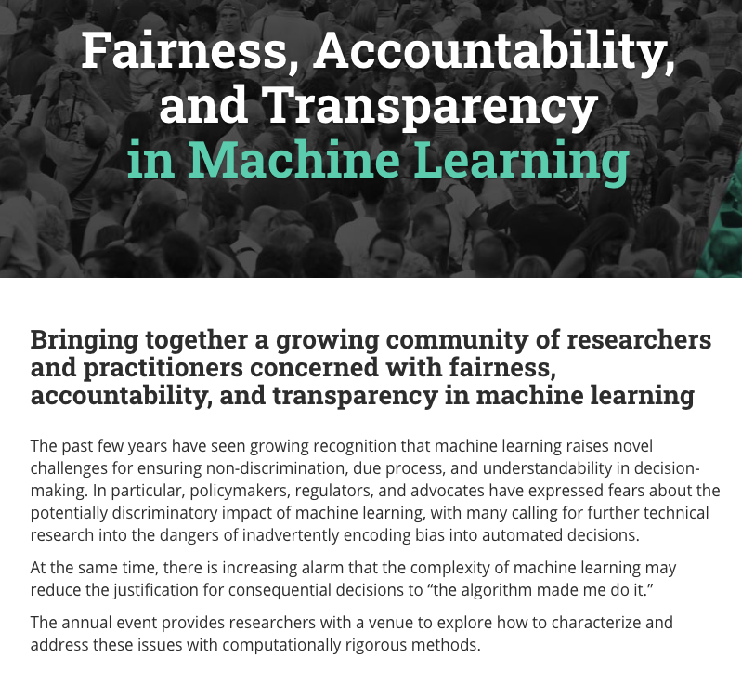
Research
DSSI 2024

Slide 36

Outreach
DSSI 2024

Slide 37
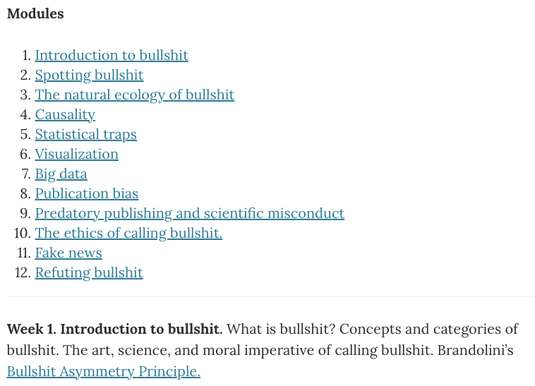
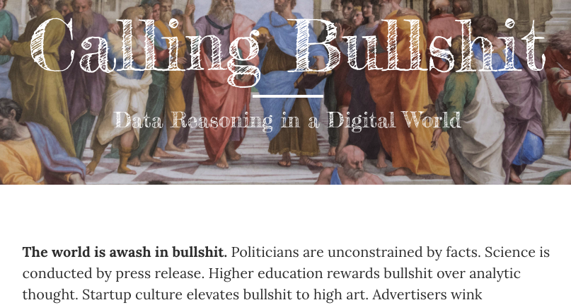
Educating Data Scientists
DSSI 2024

Slide 38
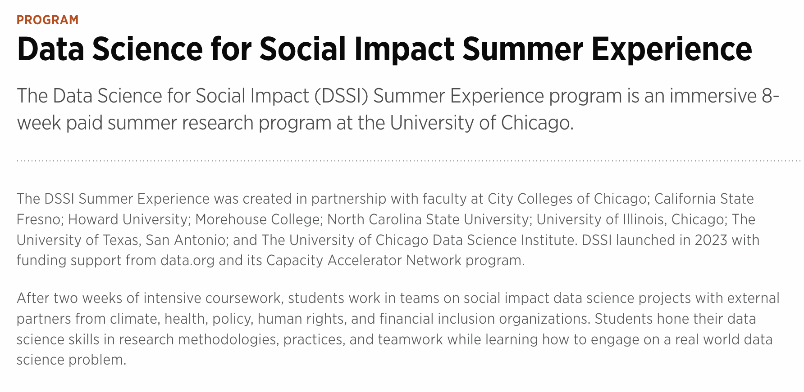
Educating Data Scientists
DSSI 2024

Slide 39
Final Thoughts
In data science, It’s just as important to think about why you are solving or should you solve that ”problem” as how to solve it.
We need to grapple with the ethical challenges and develop rigorous and guiding ethical frameworks for this constantly evolving field
Good (or great!) and important work can and should be done and YOU will do it!!
DSSI 2024

